Slide 1

ENERGY MARKET AND BATTERY OPTIMISATION
Industry Project
Group 15: Wimpy Kids
Hester, Kennedy, Chieh-Yu, Sean, Rui Wang

Slide 2
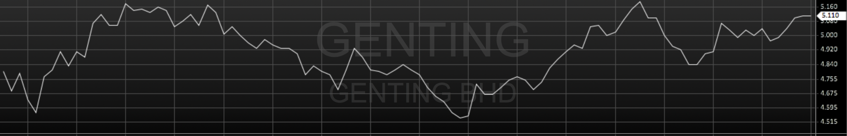


CONCEPT
National Electricity Market (NEM)
Spot Price every 30 minutes Interval
Notes:
https://www.vectorstock.com/royalty-free-vector/boxing-battery-character-cartoon-style-vector-19383093

Slide 3
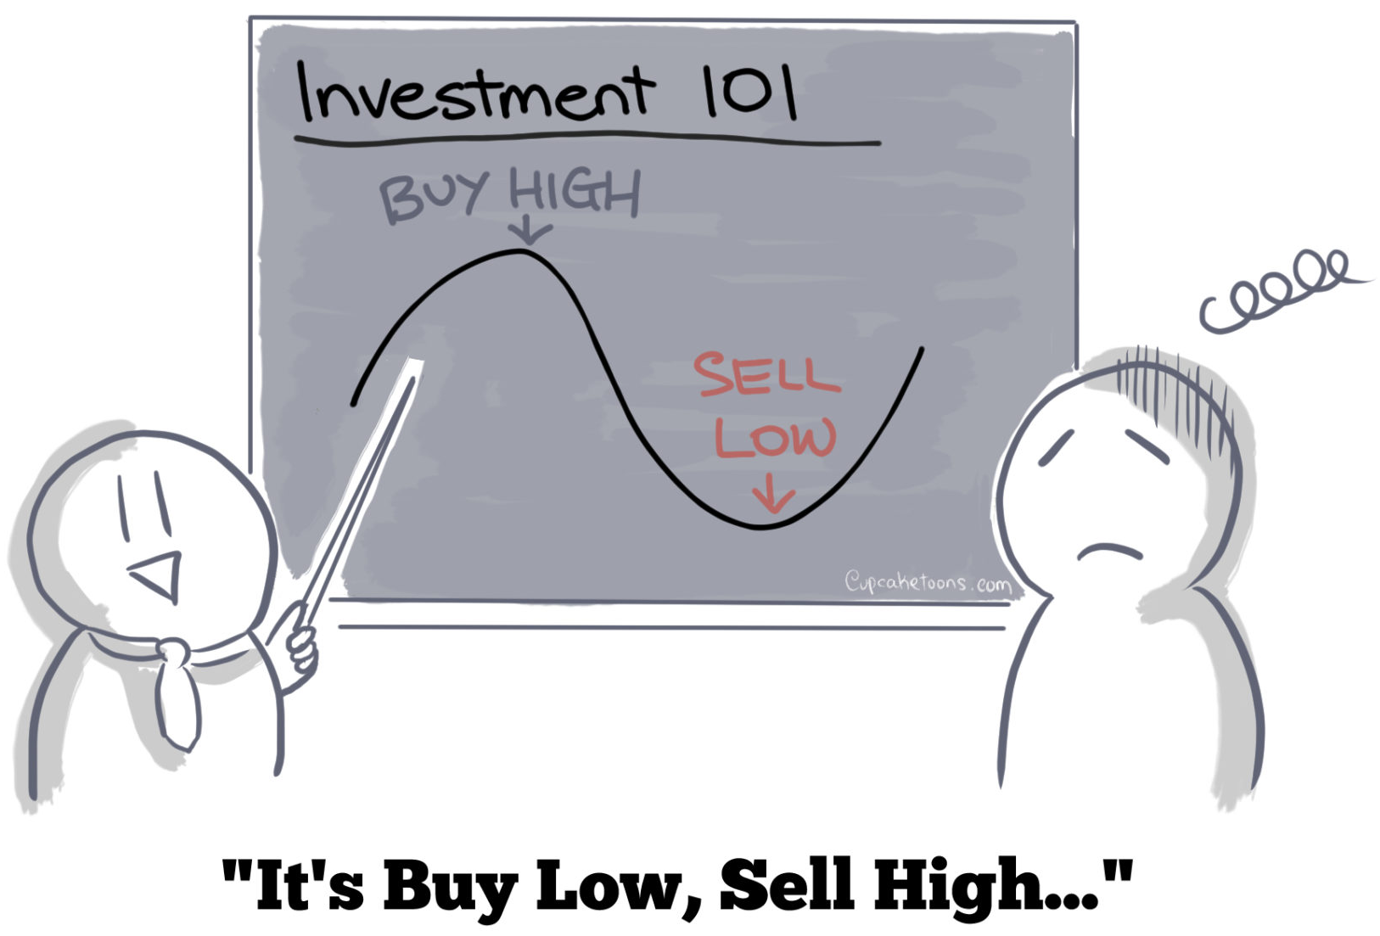
OBJECTIVE
It’s simple…...isn’t it?
Notes:
Reference :
cupcaketoons.comIt's Buy Low, Sell High – cupcaketoons.com

Slide 4
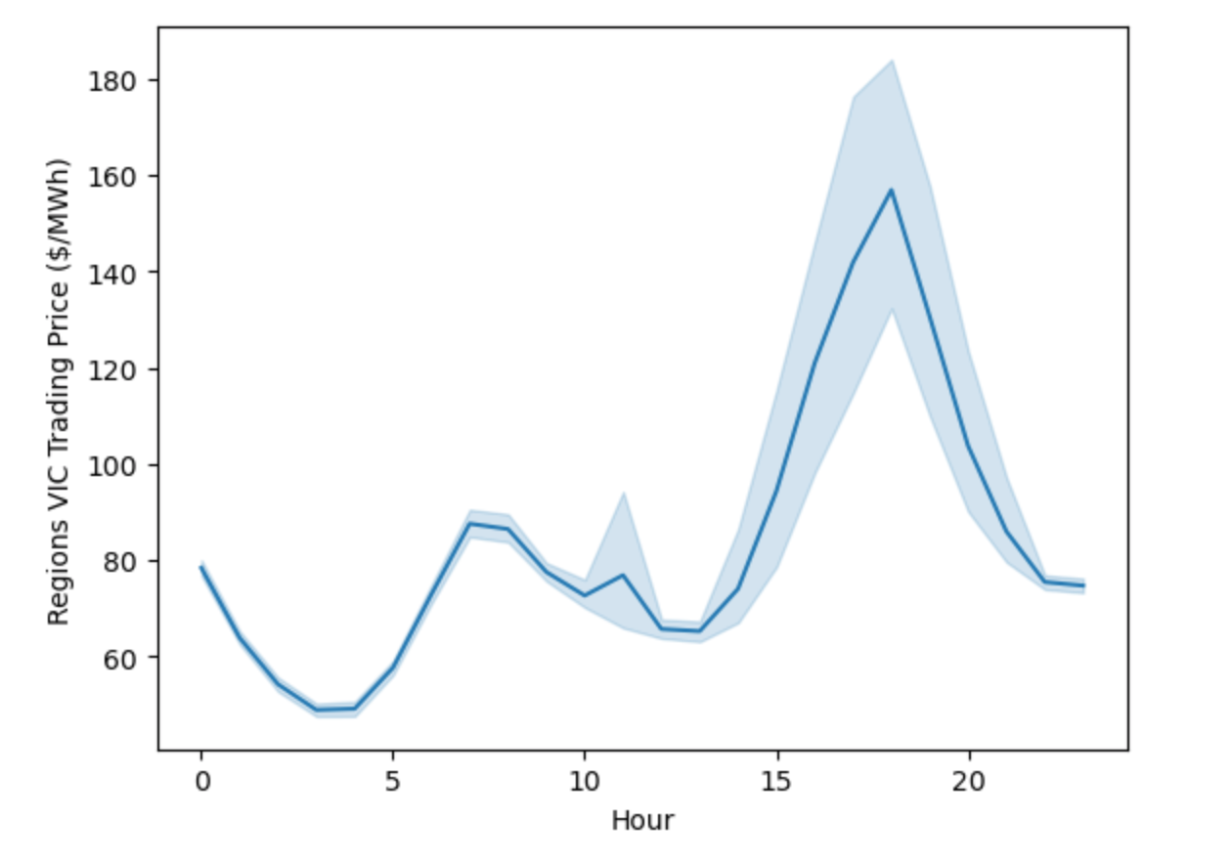
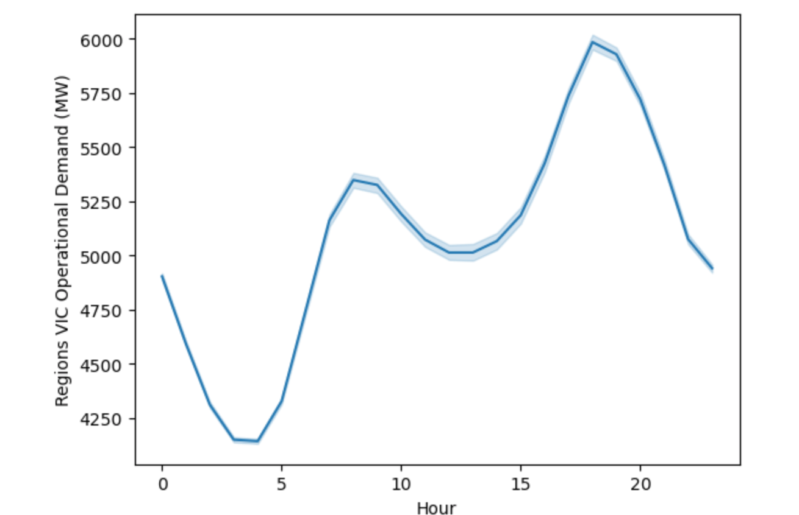
HOURLY ANALYSIS
Price v.s Hour
Demand v.s Hour
Notes:
Midnight: Low Price & Low Demand
Evening: High Price & High Demand
Seems to suggest that charge on Midnight and discharge on Evening

Slide 5
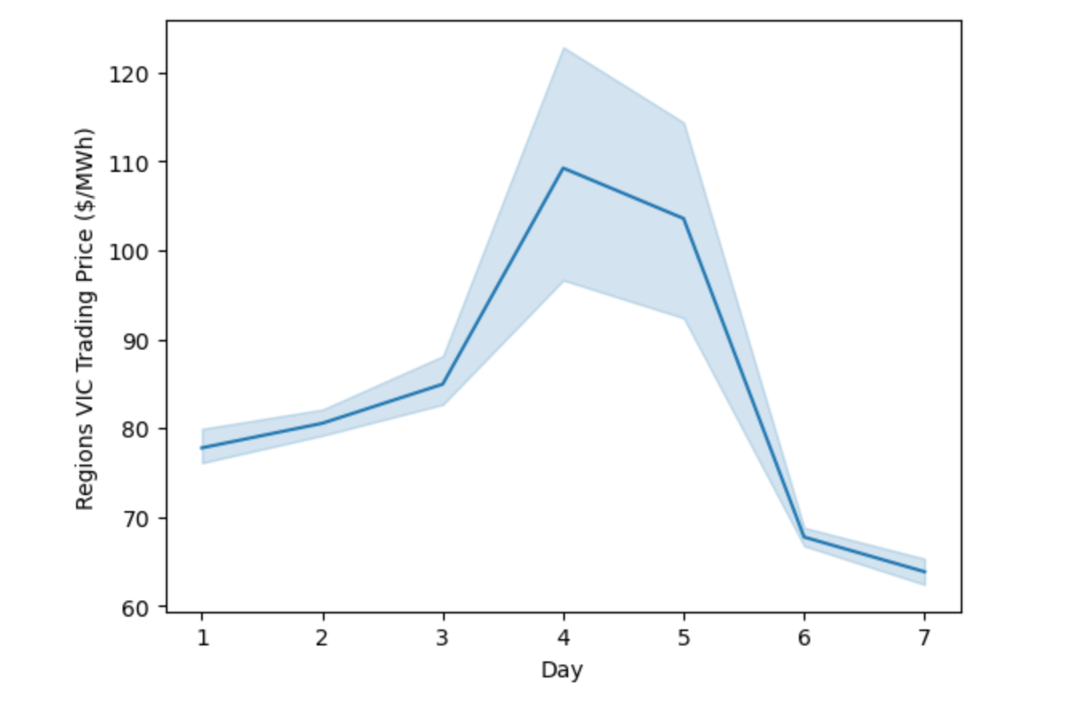
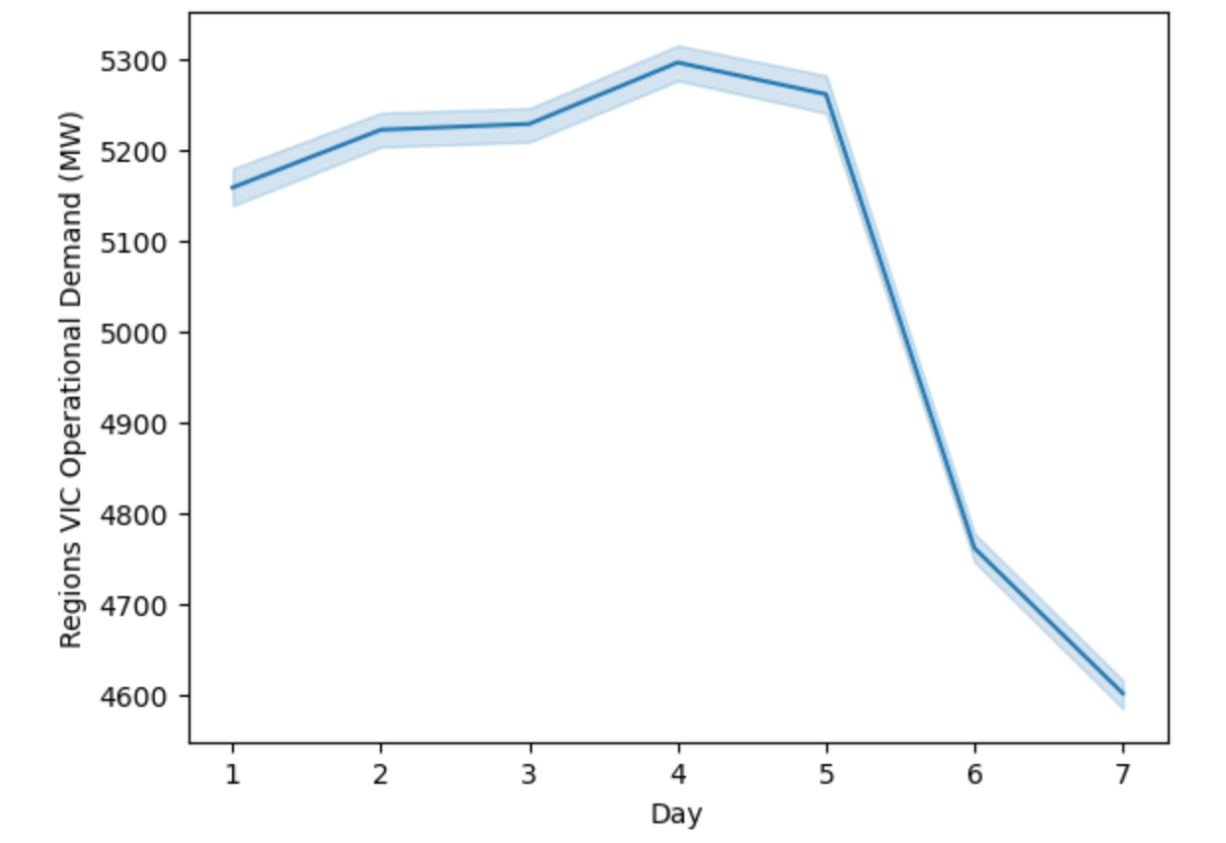
DAILY ANALYSIS
Price v.s Day
Demand v.s Day
Notes:
Sunday: Low Price & Low Demand
Thursday: High Price & High Demand
Seems to suggest that charge on Sunday, discharge on Thursday

Slide 6
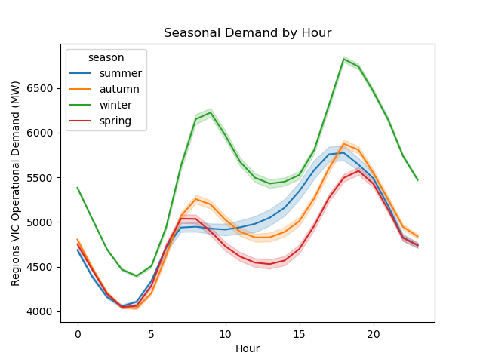
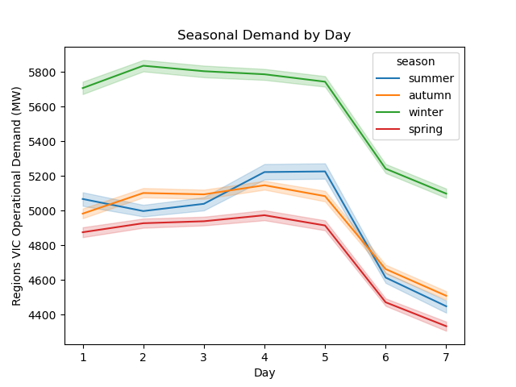
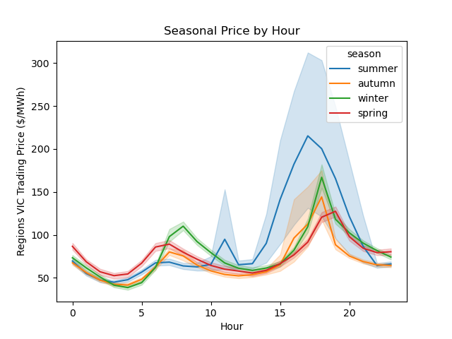
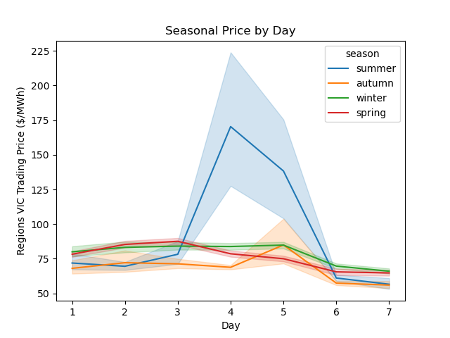
SEASONAL ANALYSIS
Operational Demand
Spot Prices

Slide 7
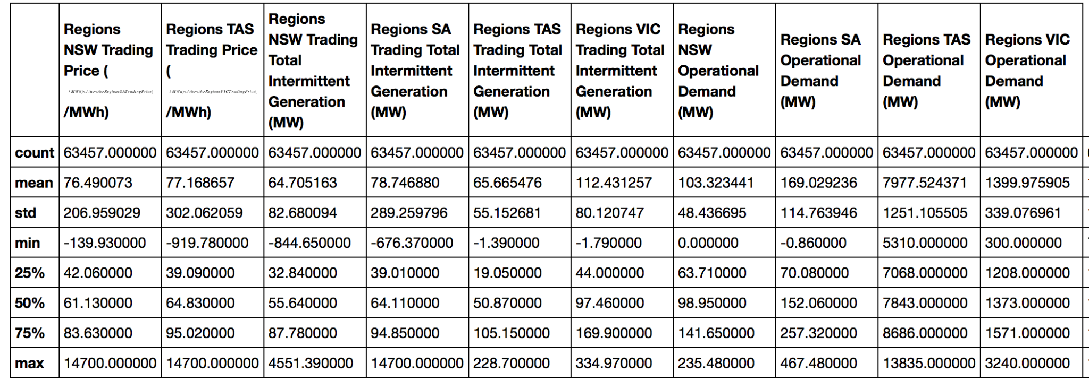
OUR ASSUMPTION
Negative Trading Price
Negative Power Generated

Slide 8
MAXIMISING REVENUES ASSUMING PERFECT FUTURE PRICE VISIBILITY
Mandatory Task
$

Slide 9
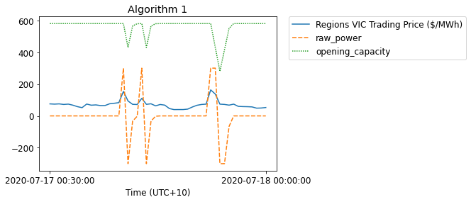
ALGORITHM 1 : FIXED CHARGE/DISCHARGE LEVELS
Revenue : AUD$ 23,475
*For 17 -18th July 2020

Slide 10
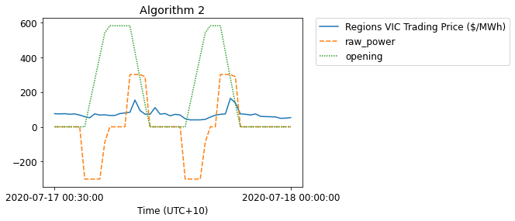
ALGORITHM 2 : TIME OF DAY CHARGE/DISCHARGE
Revenue : AUD$ 44,471
*For 17 -18th July 2020
Notes:
Visit

Slide 11
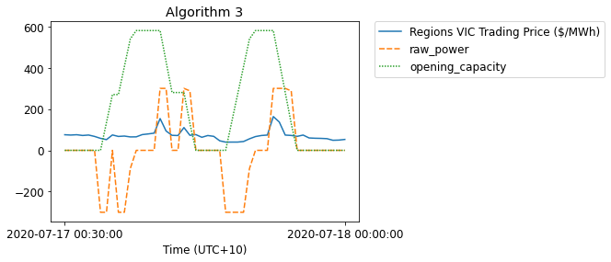
ALGORITHM 3 : LOOK AHEAD CHARGE/DISCHARGE
Revenue : AUD$ 49,239
*For 17 -18th July 2020
Notes:
Main idea of algorithm 3 is “optimization problem by breaking it down into simpler subproblems and utilizing the fact that the optimal solution to the overall problem depends upon the optimal solution to its subproblems”.
Visit

Slide 12
ALGORITHM 3 : LOOK AHEAD CHARGE/DISCHARGE
Step 1: Sort the look ahead prices
Step 2: Determine the position of the current price
Price 1 | Price 2 | Price 3 | Price 4 | Price 5 | Price 6 | Price 7 | Price 8 | Price 9 | Price 10
Charge
Do Nothing
Discharge
25th Percentile
75th Percentile
Notes:
Main idea of algorithm 3 is “optimization problem by breaking it down into simpler subproblems and utilizing the fact that the optimal solution to the overall problem depends upon the optimal solution to its subproblems”.
Visit

Slide 13
COMPARING ALGORITHMS
ALGORITHM 1 AUD$ 23,475
ALGORITHM 2 AUD$ 44,471
ALGORITHM 3 AUD$ 49,239
** For 17 - 18th July 2020

Slide 14

IMPROVEMENTS MADE TO ALGORITHM 3
Use brute-force approach to determine the parameters
Compare current price against mean of lookahead prices in addition to percentile
Discharge during idle periods
Notes:
Main idea of algorithm 3 is “optimization problem by breaking it down into simpler subproblems and utilizing the fact that the optimal solution to the overall problem depends upon the optimal solution to its subproblems”.
Visit

Slide 15
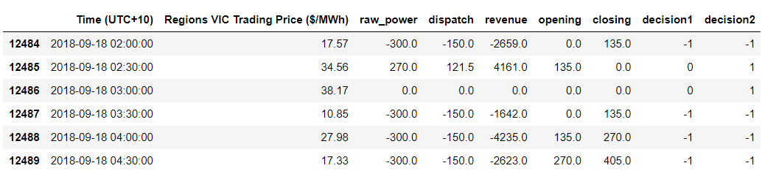
MAIN IMPROVEMENT: DISCHARGE WHEN IDLE
Step 1: Find idle periods that lies between charges
Step 2: Find out if the prices are enough to make a profit
Notes:
Main idea of algorithm 3 is “optimization problem by breaking it down into simpler subproblems and utilizing the fact that the optimal solution to the overall problem depends upon the optimal solution to its subproblems”.
Visit

Slide 16
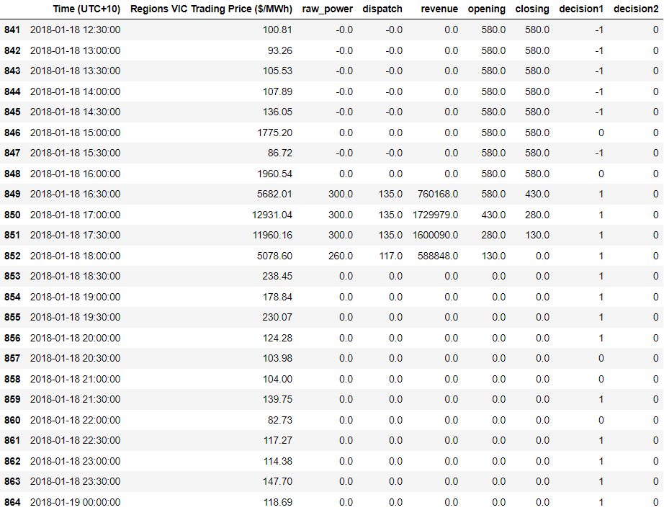

SECOND HALF DAY ON 2018-01-18 WITHOUT IMPROVEMENT
TOTAL REVENUE:
$ 4.67 MILLION

Slide 17
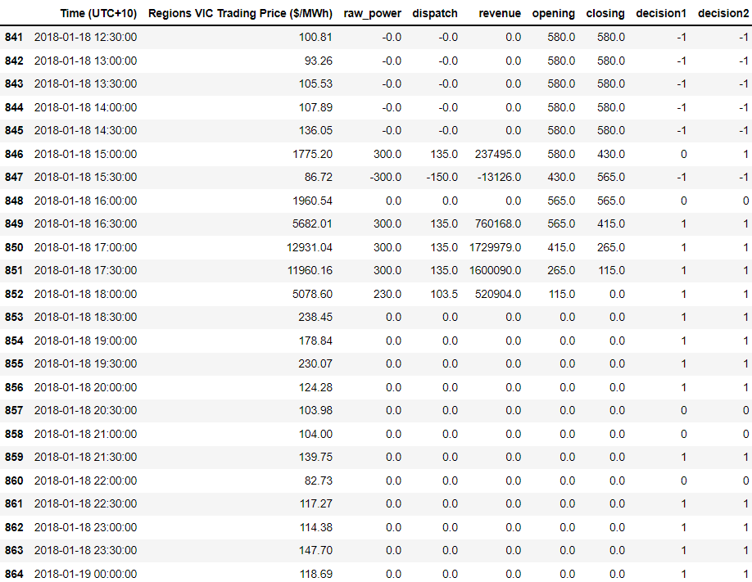

SECOND HALF DAY ON 2018-01-18 WITH IMPROVEMENT
TOTAL REVENUE:
$ 4.84 MILLION
ADDITIONAL REVENUE OF:
$ 156,425

Slide 18
REVENUE COMPARISON FOR THE WHOLE DATASET
Algorithm 1 | $ 33,109,325 | $ 25,044.48 / day
Algorithm 2 | $ 57,930,542 | $ 43,820.69 / day
Algorithm 3 | $ 118,104,744 | $ 89,336.52 / day
Our Algorithm | $ 121,122,068 | $ 91,618.88 / day
** AN INCREASE OF $3 MILLION **
** $2,300 MORE PER DAY **

Slide 19
MAXIMISING REVENUES WITHOUT FUTURE PRICE VISIBILITY
Bonus Task
$

Slide 20
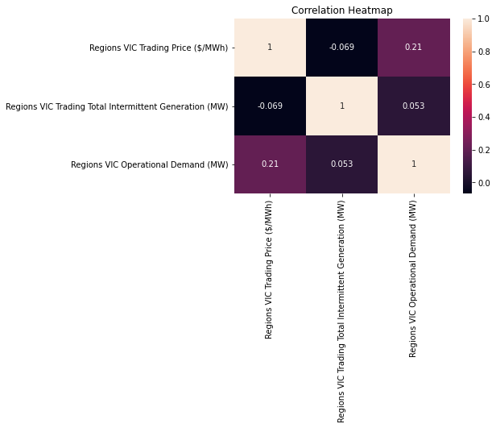
WHY NOT LINEAR REGRESSION?

Slide 21
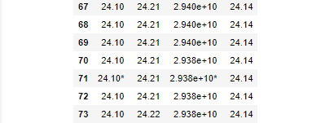
SPOT PRICE PREDICTION (VECTOR AUTOREGRESSION)
Step 1: Check the causality between Trading Total Intermittent Generation,Demand and Spot Price
Step 2: Fit model and select order of model.

Slide 22
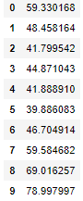
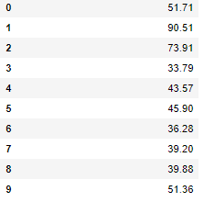
SPOT PRICE PREDICTION (VECTOR AUTOREGRESSION)
Step 3: Fit VAR model with selected order and do the prediction.(10 values in example)
Prediction
True Price
How’s our prediction?

Slide 23
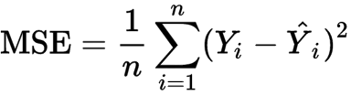
SPOT PRICE PREDICTION (VECTOR AUTOREGRESSION)
Step 4: Evaluate the forecasts by using MSE (2021/7/1 ~ 2021/8/11)
MSE=10485
What causes such large MSE?
The order of the model
The frequency of the Time series
Lack of information in Training features

Slide 24
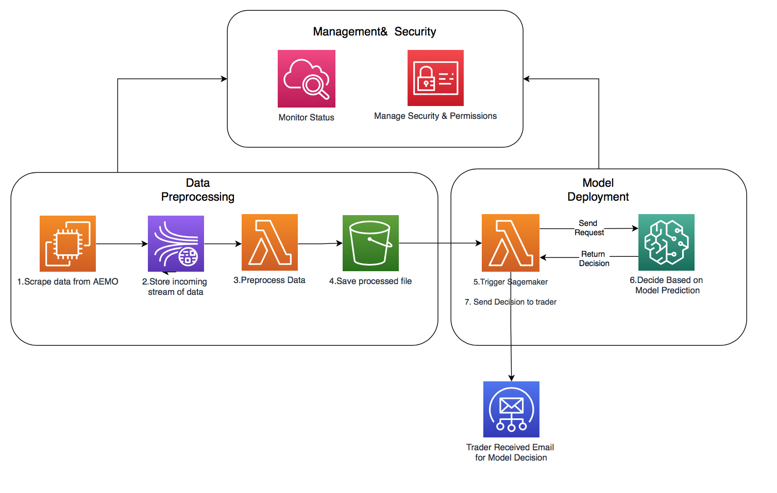
IMPLEMENTATION: ARCHITECTURE
Only authorised users can access certain services

Slide 25

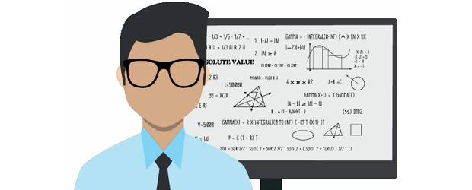


IMPLEMENTATION: TEAM

Slide 26

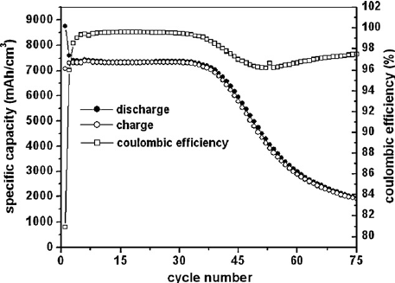

BUSINESS INSIGHT: LIMITATIONS & IMPROVEMENTS
No Future Price Visibility
Add External Dataset
Non-linear Battery Efficiency

Slide 27

BUSINESS INSIGHT: TIMELINE
Commercially Viable Product :
6
months

Slide 28

BUSINESS INSIGHT: FINANCIAL ESTIMATE
33, 400, 891. 17
Revenue
99.4
Cost
33, 097, 274.66
AUD ($)
341, 832
1, 784. 51
Revenue
Cost of Server
Cost of Hiring
Operating Income

Slide 29
CONCLUSION
Mandatory Task:
Utilized future price visibility
Gained a revenue of 121.1 million dollars
Bonus Task:
Utilized Vector AutoRegression to predict future prices
The prediction shows large mean square error.
Can change the order of the model to improve prediction accuracy
Business Context:
Financially feasible
Helps gain around 33 million dollars of annual operating income

Slide 30


THANK YOU
Notes:
https://www.google.com/search?q=thank+you+clipart&rlz=1C5CHFA_enTW922TW922&sxsrf=AOaemvK3udmAEQKvVBdGYVKwI2nUm910HA:1633783565093&source=lnms&tbm=isch&sa=X&sqi=2&ved=2ahUKEwiUvKWIrr3zAhWlm2oFHb9wDaoQ_AUoAXoECAIQAw&biw=1312&bih=695&dpr=2#imgrc=gFWrOp4CwHh0FM

